Slide 1
Cs 429: DATA MINING Lecture 3

Slide 2
Input
Concepts
Things to be learned
Instances
Usually Individual and Independent examples of Concepts
Attributes/Features
Fixed and Predefined set that measures different aspects of Instances
Can be Categorical (Finite, Distinct and Prespecified) or Numeric (Integer or Real)

Slide 3

Categorical Attributes
Nominal
Ordinal
Interval
Ordered and measured in fixed units
E.g. differences in Dates, Temperatures (numerical)
Ratio
Starting from zero
E.g. Distance

Slide 4
Concept -> Concept Description
Concept Description
Learning Object that is Intelligible and Operational
Learning | Concept Description
Classification | Classes
Association | Associations
Clustering | Groups
Numeric Prediction | Numeric Quantity

Slide 5
Instances
Examples might be related (e.g. a Family Tree)
Peter
M
Peggy
F
Grace
F
Ray
M
=
=
Steven
M
Graham
M
Pam
F
Ian
M
Pippa
F
Brian
M
=
Anna
F
Nikki
F

Slide 6
Instances
Different ways of expressing same Concept
Name
Gender
Parent1
Parent2
Peter
Male
?
?
Peggy
Female
?
?
Steven
Male
Peter
Peggy
Graham
Male
Peter
Peggy
Pam
Female
Peter
Peggy
Ian
Male
Grace
Ray
Pippa
Female
Grace
Ray
Brian
Male
Grace
Ray
Anna
Female
Pam
Ian
Nikki
Female
Pam
Ian

Slide 7
Instances
Different ways of expressing same Concept
Closed World assumption
First person
Second person
Sister of?
First person
Second person
Sister of?
Peter
Peggy
No
Steven
Pam
Yes
Peter
Steven
No
Graham
Pam
Yes
…
…
…
Ian
Pippa
Yes
Steven
Peter
No
Brian
Pippa
Yes
Steven
Graham
No
Anna
Nikki
Yes
Steven
Pam
Yes
Nikki
Anna
Yes
…
…
…
All the rest
No
Ian
Pippa
Yes
…
…
…
Anna
Nikki
Yes
…
…
…
Nikki
Anna
yes

Slide 8
Instances
Different ways of expressing same Concept
Closed World assumption
First person
Second person
Sister of?
Name
Gender
Parent1
Parent2
Name
Gender
Parent1
Parent2
Steven
Male
Peter
Peggy
Pam
Female
Peter
Peggy
Yes
Graham
Male
Peter
Peggy
Pam
Female
Peter
Peggy
Yes
Ian
Male
Grace
Ray
Pippa
Female
Grace
Ray
Yes
Brian
Male
Grace
Ray
Pippa
Female
Grace
Ray
Yes
Anna
Female
Pam
Ian
Nikki
Female
Pam
Ian
Yes
Nikki
Female
Pam
Ian
Anna
Female
Pam
Ian
Yes
All the rest
No
If second person’s gender = female and first person’s parent1 = second person’s parent1 then sister-of = yes

Slide 9
Instances
Different ways of expressing same Concept
Closed World assumption
First person
Second person
Ancestor of?
Name
Gender
Parent1
Parent2
Name
Gender
Parent1
Parent2
Peter
Male
?
?
Steven
Male
Peter
Peggy
Yes
Peter
Male
?
?
Pam
Female
Peter
Peggy
Yes
Peter
Male
?
?
Anna
Female
Pam
Ian
Yes
Peter
Male
?
?
Nikki
Female
Pam
Ian
Yes
Pam
Female
Peter
Peggy
Nikki
Female
Pam
Ian
Yes
Grace
Female
?
?
Ian
Male
Grace
Ray
Yes
Grace
Female
?
?
Nikki
Female
Pam
Ian
Yes
Other positive examples here
Yes
All the rest
No

Slide 10
Output
Decision Tables
Decision Trees
Classification Rules
Association Rules
Rules with Exceptions
Rules involving Relations
Trees for Numeric Prediction
Instance-based Representation
Clusters

Slide 11
Output
Decision Tables
Decision Trees
Classification Rules
Association Rules
Rules with Exceptions
Rules involving Relations
Trees for Numeric Prediction
Instance-based Representation
Clusters

Slide 12
Decision Tables
Weather Forecast Data 1
S# | Outlook | Temperature | Humidity | Windy | Play
1 | sunny | hot | high | false | no
2 | sunny | hot | high | true | no
3 | overcast | hot | high | false | yes
4 | rainy | mild | high | false | yes
5 | rainy | cool | normal | false | yes
6 | rainy | cool | normal | true | no
7 | overcast | cool | normal | true | yes
8 | sunny | mild | high | false | no
9 | sunny | cool | normal | false | yes
10 | rainy | mild | normal | false | yes
11 | sunny | mild | normal | true | yes
12 | overcast | mild | high | true | yes
13 | overcast | hot | normal | false | yes
14 | rainy | mild | high | true | no

Slide 13
Decision Tables
Output
S# | Outlook | Humidity | Windy | Play
1 | sunny | high | false | no
2 | sunny | high | true | no
3 | overcast | high | false | yes
4 | rainy | high | false | yes
5 | rainy | normal | false | yes
6 | rainy | normal | true | no
7 | overcast | normal | true | yes
8 | sunny | high | false | no
9 | sunny | normal | false | yes
10 | rainy | normal | false | yes
11 | sunny | normal | true | yes
12 | overcast | high | true | yes
13 | overcast | normal | false | yes
14 | rainy | high | true | no

Slide 14
Output
Decision Tables
Decision Trees
Classification Rules
Association Rules
Rules with Exceptions
Rules involving Relations
Trees for Numeric Prediction
Instance-based Representation
Clusters

Slide 15
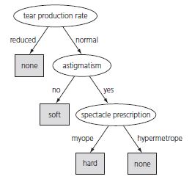
Decision Trees
Contact Lenses Problem

Slide 16
Decision Trees
Divide-and-Conquer approach
Parent-Child relationships
Each attribute usually tested once only
Categorical vs. Numeric Attributes
Missing Values
Not necessarily Errorless Classification
Classifying an Unknown Instance

Slide 17
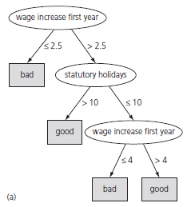
Decision Trees
Labor Negotiations Contracts Problem

Slide 18
Output
Decision Tables
Decision Trees
Classification Rules
Association Rules
Rules with Exceptions
Rules involving Relations
Trees for Numeric Prediction
Instance-based Representation
Clusters

Slide 19
Classification Rules
Antecedent: Precondition
Consequent: Conclusion
Conjunction: Antecedents ANDed together to fire rule
Disjunction: Rules ORed together

Slide 20
Classification Rules vs. Decision Trees
Rules from Decision Trees
One for each branch
Nesting?
Unambiguous: Order of firing of rules is irrelevant

Slide 21
Classification Rules vs. Decision Trees
Decision Trees from Rules
Tree: Root-Branch-Leaf (inverted Tree)

Slide 22
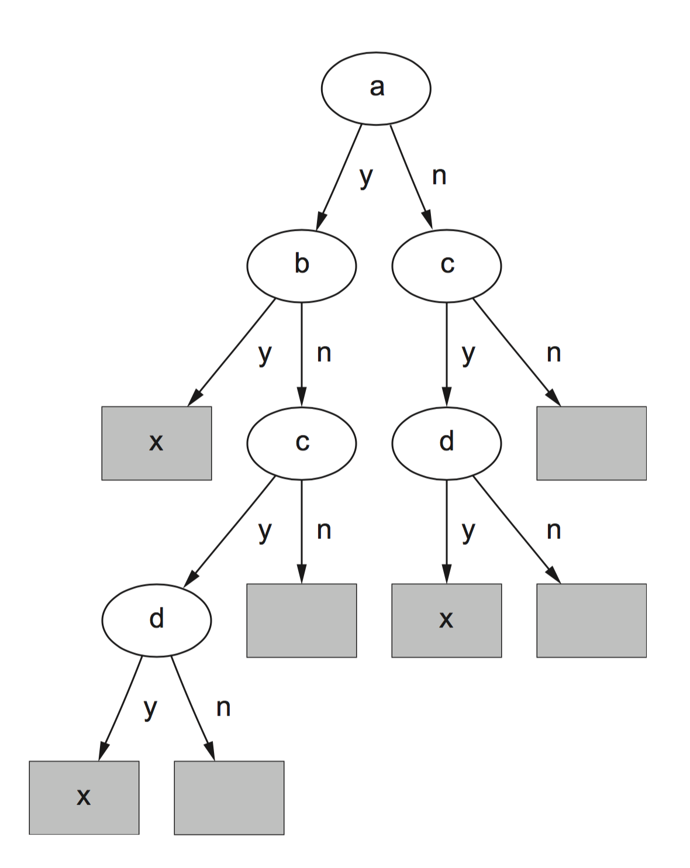
Classification Rules vs. Decision Trees
Decision Trees from Rules
Replicated Subtree Problem
Simple Disjunction
If a and b then x
If c and d then x

Slide 23
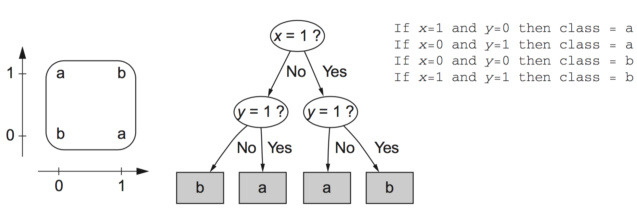
Classification Rules vs. Decision Trees
Decision Trees from Rules
Replicated Subtree Problem
Exclusive-OR Function

Slide 24
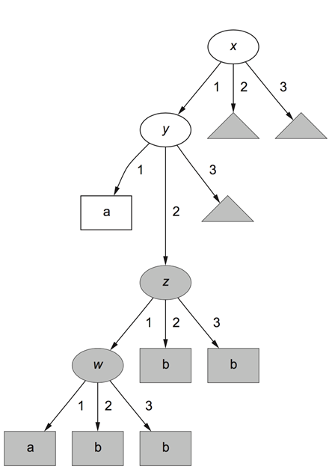

Classification Rules vs. Decision Trees
Decision Trees from Rules
Replicated Subtree Problem
Rule Set with Default rule

Slide 25
Classification Rules vs. Decision Trees
Characteristic | Classification Rules | Decision Trees
Compactness | Particular Cases | Generally
Updations | Easy | Difficult
Conflicting Recommendations | Yes | No
None of the rules apply | Yes | No
Unambiguous | Closed World Assumption | All the time

